Slide 1

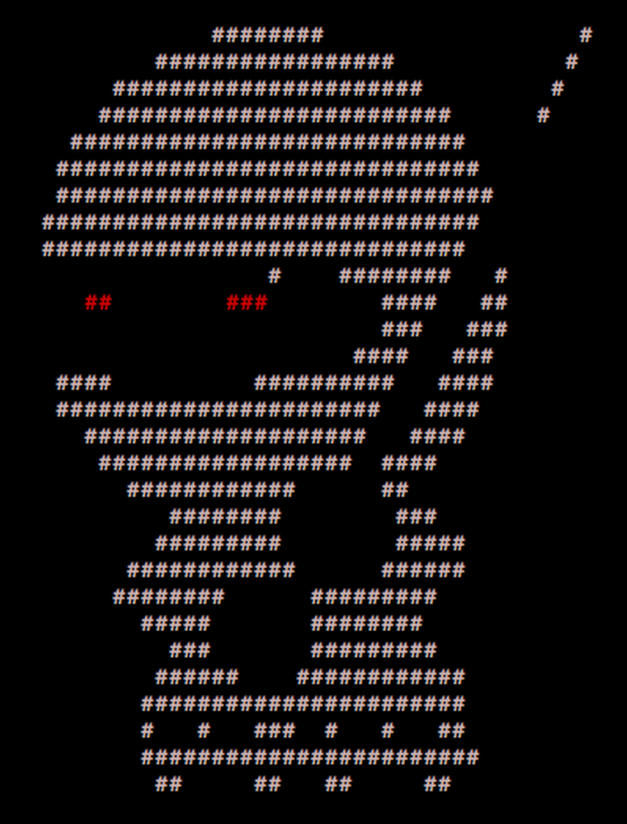
____ _____ _ _
/ ___| ___ __|_ _|_ _| | | _____
\___ \ / _ \/ __|| |/ _` | | |/ / __|
___) | __/ (__ | | (_| | | <\__ \
|____/ \___|\___||_|\__,_|_|_|\_\___/
PER0x59
Technical (in)security talks & hands-on challenges, no bullshit!
Technical (in)security talks & hands-on challenges, no bullshit!

Slide 2
Welcome!
We’re virtually back again!
Technical (in)security talks & hands-on challenges, no bullshit!

Slide 3
SecTalks PER0x59
Thanks to…
Spacecubed & Riff!
The committee: nidogski & sudosammy
drunkrhin0 & Bugcrowd for the Zooms
Everyone who contributes!
Technical (in)security talks & hands-on challenges, no bullshit!

Slide 4
Speakers PER0x59
#1 – Michael Hyndman Bio: Michael is the VP of Cyber Security for the global leader in cyber safety - Family Zone - based here in Perth. At Family Zone he leads the security strategy which is focussed on securing the business and the products that protect millions of kids around the world.
Michael is also an ethical hacker and top Bug Bounty hunter; he has hacked over 50 companies/products - most are well known brands - and work's with them to improve their security.
He enjoys all things security and loves meeting new people in this industry.
Synopsis: Bug bounties can be very rewarding and lots of fun. In this session we'll cover how I got an edge on the crowd and break down some of my methods and approaches to cracking open mobiles, clouds and proxies.
Technical (in)security talks & hands-on challenges, no bullshit!

Slide 5

SecTalks PER0x5A
Date: ????
(the randomest day of every month)
Speaker: ??? ← This could be you!
Title: ??? ← This could be anything!
https://goo.gl/4eT53i
This could be malicious! →
Technical (in)security talks & hands-on challenges, no bullshit!

Slide 6



Stay in touch
IRC / SLACK
irc.sectalks.org > #sectalks
and / or ask to be added to the slack
GitHub
https://github.com/sectalks/sectalks
Twitter
@SecTalks
Technical (in)security talks & hands-on challenges, no bullshit!

Slide 7
Without further ado...
Virtual drinks?
~ ~
( o )o)
( o )o )o)
(o( ~~~~~~~~o
( )' ~~~~~~~'
( )|) |-.
o| _ |-. \
o| |_||_) | \ \
| | ||_) | | |
o| | / /
| |." "
| |- '
.========.
Technical (in)security talks & hands-on challenges, no bullshit!

